Slide 1
COMP 3069 Computer Graphics
Lecture 3:
Transformation
Autumn 2018

Slide 2
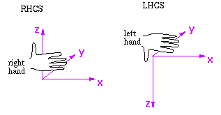
Coordinate System (we use)

Slide 3
3D Transformation
In the modeling lecture we saw how to define an object in terms of its polygons/edges/vertices in object space
We will now see how to use transformations to move objects around
In computer graphics a transformation is represented by a matrix - to transform an object is to multiply the vertices (represented as vectors) of the object with the matrix
The vertices of objects are usually represented using homogeneous coordinates, which adds an extra component to the vertex vector

Slide 4
3D Transformations
3 commonly used transformations are:
Scaling – making objects bigger/smaller
Translating – moving object around
Rotating – rotating objects in space
e.g., Scale by 2
e.g., Translate by (1, 1)
e.g., Rotate 90°

Slide 5
3D Scaling Matrix
By multiplying a point (x,y,z,1) by a scaling matrix we turn it to (S_{x}x, S_{y}y, S_{z}z,1), all coordinates are scaled
We use homogeneous coordinates. This allows us to represent all transformations (e.g., scale, rotate, translate) using matrices
Scaling
coefficients
in x, y, z
directions

Slide 6
Scaling Example
Make the triangle twice as tall but half as wide
y
y
(0, 2, 0)
(0, 1, 0)
x
x
(-1, -1, 0)
(1, -1, 0)
(-0.5, -2, 0)
(0.5, -2, 0)

Slide 7
3D Translation Matrix
By multiplying a point (x,y,z,1) by the translation matrix we turn it to (x+T_{x}, y+T_{y}, z+T_{z}, 1):
Note: It won’t be possible to use a 3x3 matrix to represent the translation of a vertex; that’s why we use a 4x4 homogenous matrix instead!
Translation
in x, y, z
directions

Slide 8
Translation Example
Move the triangle back by 5 and right by 3
y
(3, 1, -5)
y
(0, 1, 0)
(2, -1, -5)
(4, -1, -5)
x
x
(-1, -1, 0)
(1, -1, 0)
z
z

Slide 9
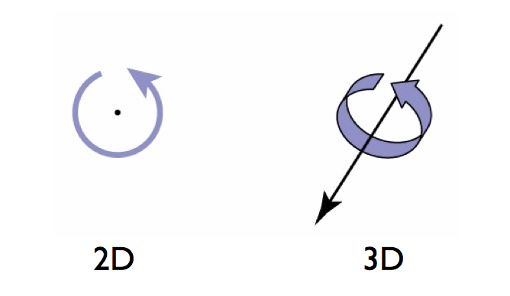
Rotation in Space

Slide 10
3D Rotation About Coordinate Axes
about X axis
about Y axis
about Z axis
y
x
z
y
x
z
y
x
z

Slide 11
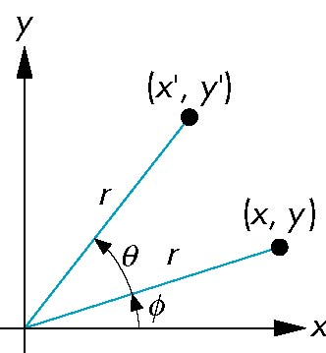
Rotation (2D) - Ignoring Z-axis
Consider rotation about the origin by θ degrees
radius stays the same, angle increases by θ
???
x = r cos φ
y = r sin φ

Slide 12
Rotation (2D) - Ignoring Z-axis
Consider rotation about the origin by θ degrees
radius stays the same, angle increases by θ
x’ = r cos (φ + θ) = r (cos (φ) cos (θ)- sin (φ) sin (θ))
y’ = r sin (φ + θ) = r (cos (φ) sin (θ)+ sin (φ) cos (θ))
x = r cos φ
y = r sin φ
x’ = x cos θ – y sin θ
y’ = x sin θ + y cos θ
Hence,

Slide 13
Rotation about the Z-axis
Rotation about z axis in three dimensions leaves all points with the same z
Equivalent to rotation in two dimensions in planes of constant z
or in homogeneous coordinates
p’ = R_{z}(θ) p = p
x’ = x cos θ –y sin θ
y’ = x sin θ + y cos θ
z’ = z

Slide 14
Matrix for Rotation about Z-axis
R_{z}(θ) =

Slide 15
Rotation about X and Y axes
Same argument as for rotation about z axis
For rotation about x axis, x is unchanged
For rotation about y axis, y is unchanged
R_{x}(θ) =
R_{y}(θ) =

Slide 16
An Example Rotation About Y-Axis
Rotate by 45°around y axis
y
y
(0, 1, 0)
(0, 1, 0)
x
x
(-0.7, -1, 0.7)
(-1, -1, 0)
(0.7, -1, -0.7)
(1, -1, 0)

Slide 17
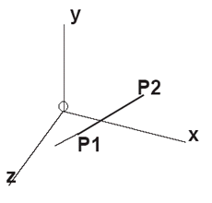
Rotation about Arbitrary Axis
Often we need rotation about a vector U that is not a coordinate axis (not X, nor Y, nor Z) and may not pass through the coordinate origin
In this situation we will align U with either X, or Y, or Z, then rotate about this coordinate axis - any transformation to align U will be applied to all objects in the scene
The translation or the rotations done to align U with the coordinate axis need to be reversed to move U back to its initial position - any transformation to move U back will be applied to all objects in the scene

Slide 18
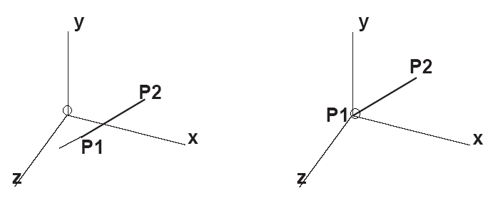

Rotation θ about an Arbitrary Axis
First, translate the vector to be incident the origin:
Rotate about X to bring it to XoZ plane
Clockwise rotate about Y to align it with Z axis
Rotate about Z is equivalent to rotation about U
Undo rotations about Y and X
Undo the beginning translation

Slide 19
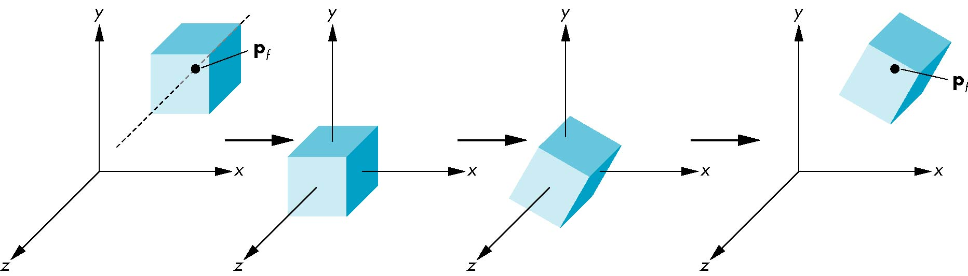
Rotation About a Fixed Point other than the Origin
Move fixed point p_{f} to origin → T(-p_{f})
Rotate → R(θ)
Move fixed point back → T(p_{f})
Hence, M = T(p_{f}) R(θ) T(-p_{f})

Slide 20
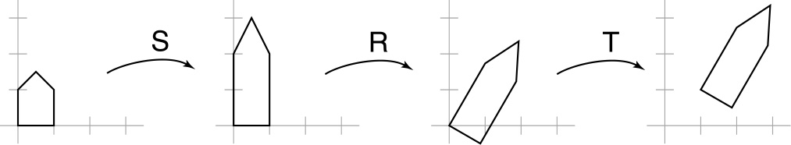
Composite Transformations
To transform an object like this:
It will take several transformations, each represented as a matrix:
Notes:
M = T R S

Slide 21
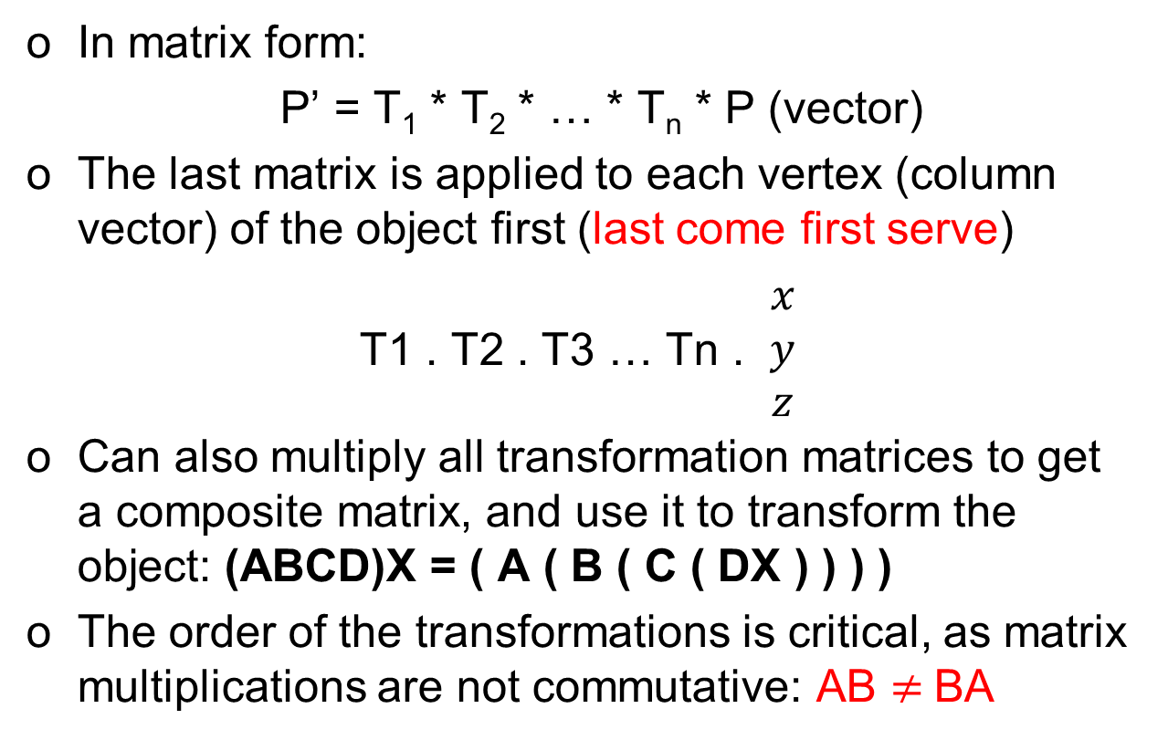
Composite Transformations

Slide 22
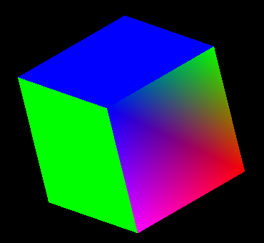
Transformation in OpenGL
FRONT - Multicolored
BACK - White
TOP - Blue
BOTTOM - Red
RIGHT - Purple
LEFT – Green
glTranslatef(0, 0, -500.0);
glScalef(100, 100, 100);
glRotated(30, 0.0, 0.0, 1.0);
glRotated(30, 0.0, 1.0, 0.0);
glRotated(30, 1.0, 0.0, 0.0);

Slide 23
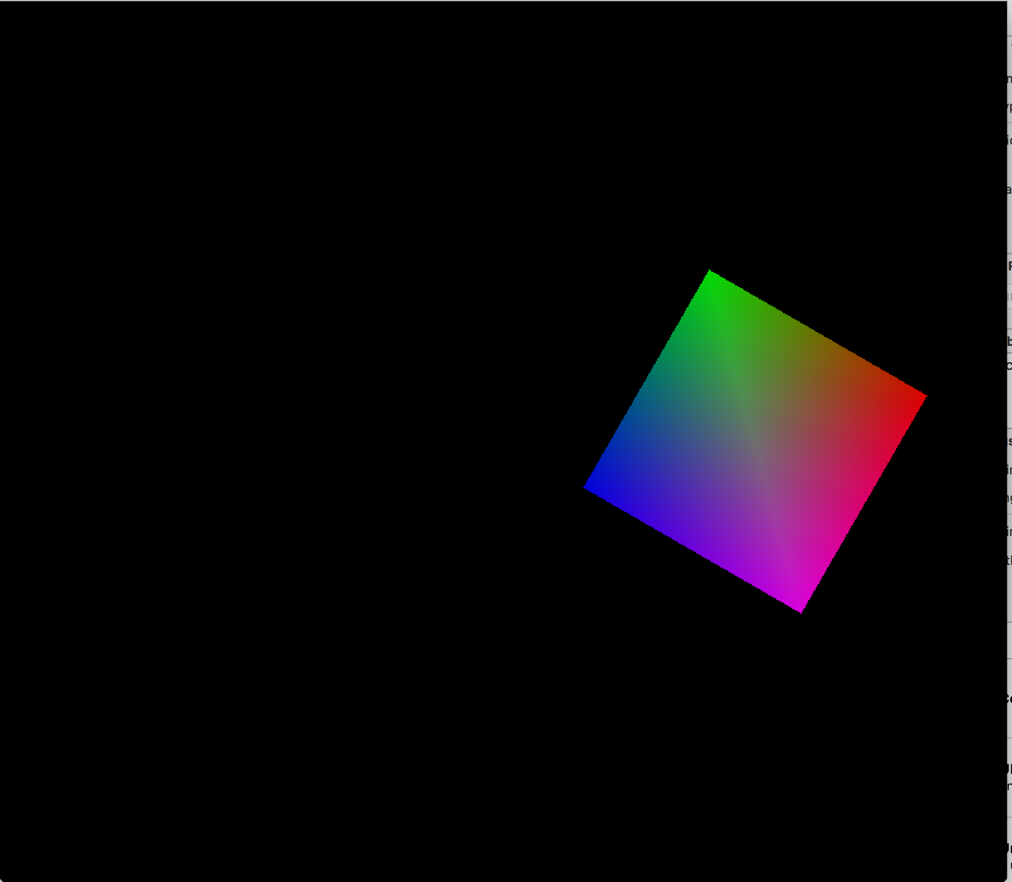

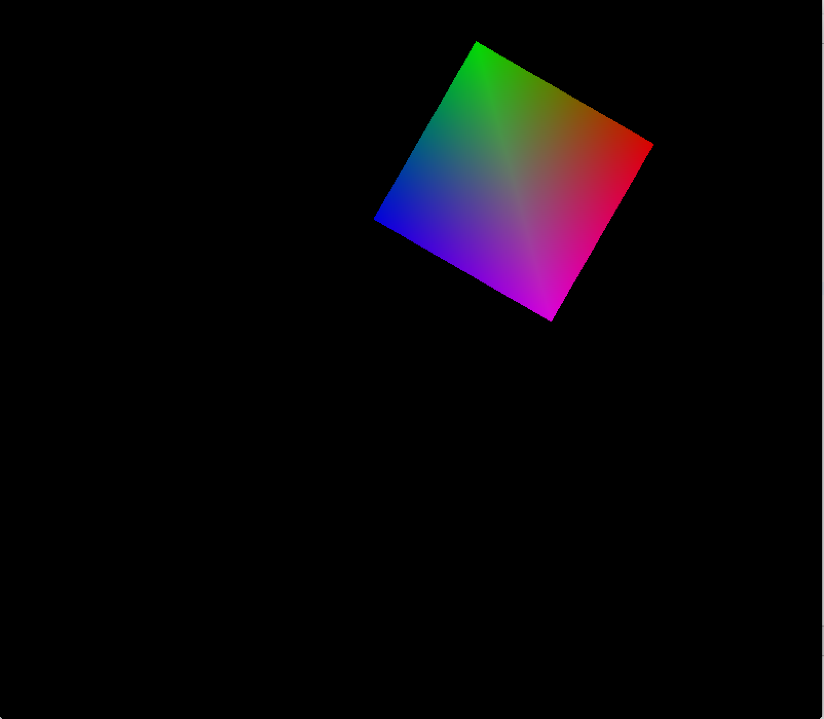
Transformation in OpenGL
glTranslatef(2.0, 0.0, 0.0);
glRotatef( 60.0, 0, 0, 1 );
Original
glRotatef( 60.0, 0, 0, 1 );
glTranslatef(2.0, 0.0, 0.0);

Slide 24
OpenGL Matrix Stacks
There are 3 transformation matrix stacks:
Model-View - glMatrixMode(GL_MODELVIEW);
Projection - glMatrixMode(GL_PROJECTION);
Texture - glMatrixMode(GL_TEXTURE);
When Model-View mode starts, usually an identity matrix is created, which becomes the ‘current matrix’ and sits on top of the matrix stack.
When other transformations are called later in the program, the current matrix is updated, e.g., right multiplied by new matrices corresponding to the transformations called.

Slide 25
OpenGL Matrix Stacks
Say you call glMatrixMode(GL_MODELVIEW), and glLoadIdentity(), OpenGL will create an identity matrix (1s on diagonal line 0s on others)
If you then call glTranslatef(0,0,-250), the current matrix will be
If you call glTranslatef(0,0,-250) again, current matrix will be:
If you then call DrawCube() – the cube will be drawn at a distance of 500 from the origin, in the -Z direction

Slide 26
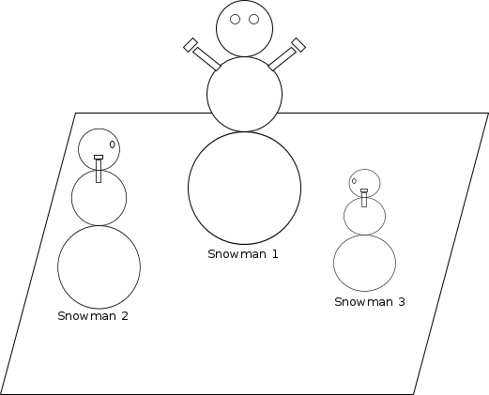
Transformation in OpenGL
Snowman 1 is at the coordinate origin, looking along the z-axis. Now draw Snowman 2, positioned 8 units along the negative x-axis, 6 units along the positive z-axis, half the size of Snowman 1, and looks down the x-axis.
y
glMatrixMode(GL_MODELVIEW)
glTranslatef(-8.0, 0.0, 6.0);
glRotatef(90.0, 0.0, 1.0, 0.0);
glScalef(0.5, 0.5, 0.5);
drawSnowman();
x
z

Slide 27
Transformation in OpenGL
y
glTranslatef(5.0, 0.0, 5.0);
glRotatef(90.0, 0.0, 1.0, 0.0);
Or
glRotatef(90.0, 0.0, 1.0, 0.0);
glTranslatef(5.0, 0.0, 5.0);
T * R * point
Or R * T * point
0
x
y
y
z
x
0
x
0
z
z

Slide 28
Exercise - (Question)
Write down the transformation that rotates an object by 45 degrees about vector U
Vector U originates from P1(0,1,0) on the XoY plane and passes point P2(1,0,0) on the X axis
Question: What’s , and rotation should be about which axis?
y
P1(0,1,0)
P2(1,0,0)
x
o
z

Slide 29
Exercise – (Solution)
P1 and P2 are on XoY plane, so vector P1P2 is on XoY plane
After translation to the origin vector P1’P2’ is still on the XoY plane, and can be rotated by 45 around Z-axis to align with X-axis
The composite matrix for rotation around P1P2 is
y
P1(0,1,0)
P2(1,0,0)
x
o
z
translate to move the end of the vector to origin,
rotate about z to align the vector with x, then rotate about x,
undo rotation about z-axis and undo the translation

